Slide 1
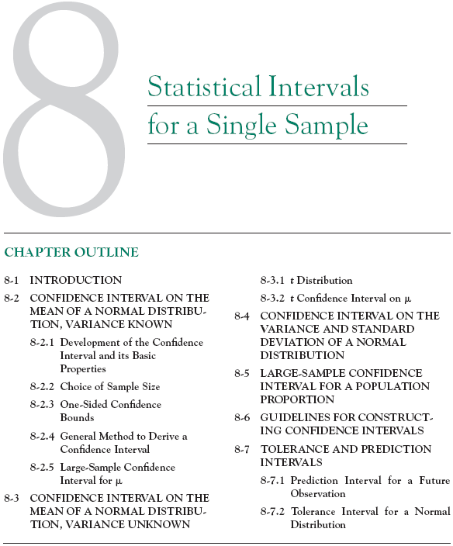

Slide 2













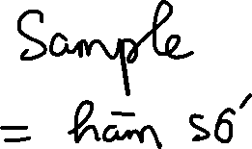

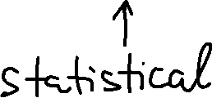



Slide 3
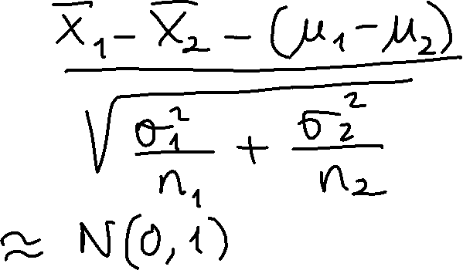



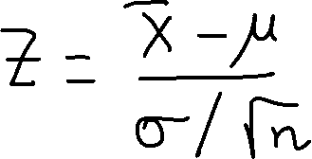


Slide 4
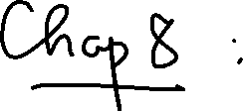

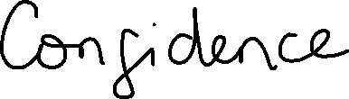


Slide 5
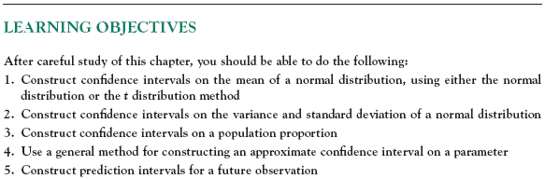

Slide 6






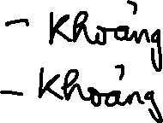
8-1 Introduction
In the previous chapter we illustrated how a parameter can be estimated from sample data. However, it is important to understand how good is the estimate obtained.
Bounds that represent an interval of plausible values for a parameter are an example of an interval estimate.
Three types of intervals will be presented:
Confidence intervals
Prediction intervals
Tolerance intervals

Slide 7
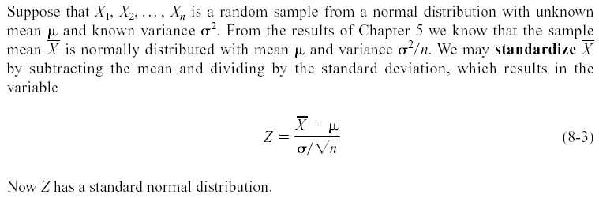


8-2 Confidence Interval on the Mean of a Normal Distribution, Variance Known
8-2.1 Development of the Confidence Interval and its Basic Properties

Slide 8



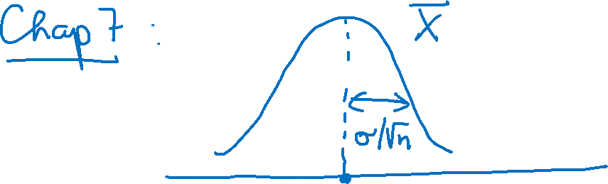



Slide 9
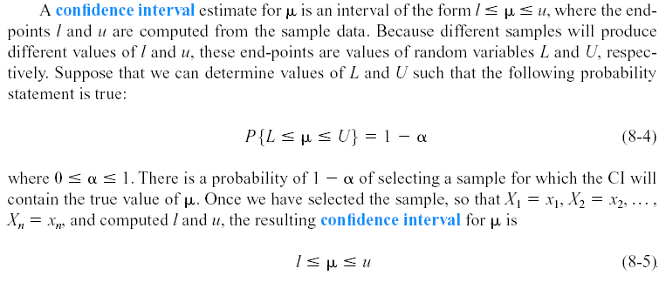






8-2 Confidence Interval on the Mean of a Normal Distribution, Variance Known
8-2.1 Development of the Confidence Interval and its Basic Properties

Slide 10










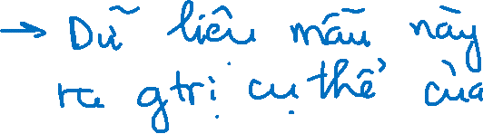





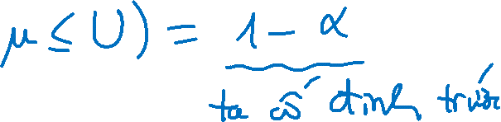


Slide 11















Slide 12

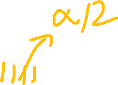

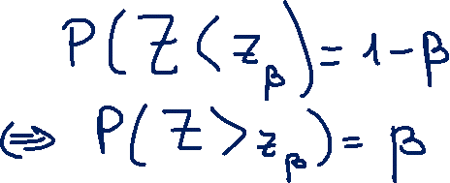


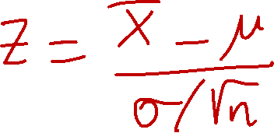




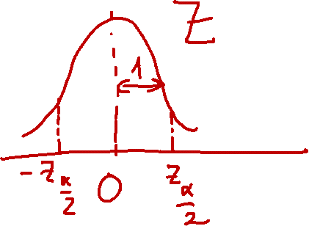
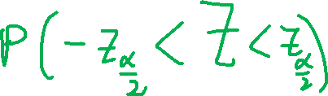

Slide 13
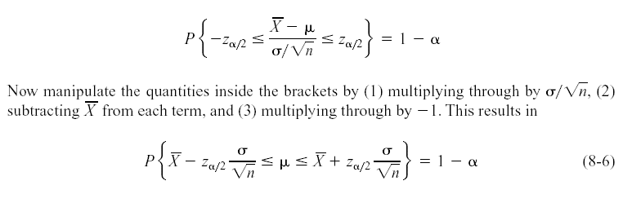
8-2 Confidence Interval on the Mean of a Normal Distribution, Variance Known
8-2.1 Development of the Confidence Interval and its Basic Properties
The endpoints or bounds l and u are called lower- and upper-confidence limits, respectively.
Since Z follows a standard normal distribution, we can write:

Slide 14
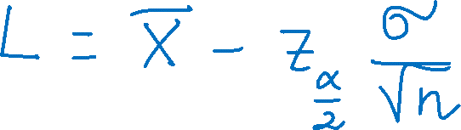


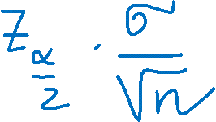

Slide 15










8-2 Confidence Interval on the Mean of a Normal Distribution, Variance Known
8-2.1 Development of the Confidence Interval and its Basic Properties
Definition

Slide 16
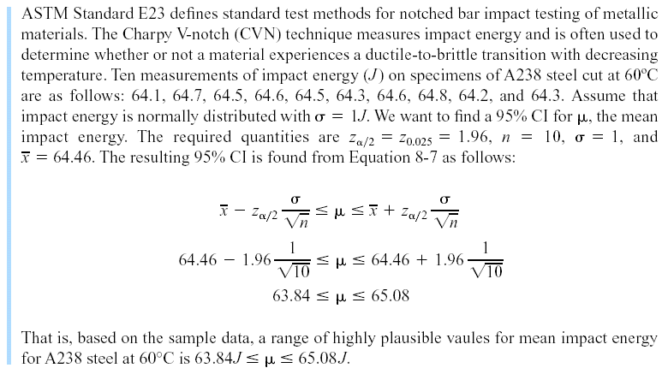

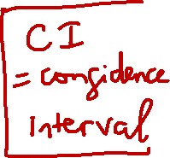
8-2 Confidence Interval on the Mean of a Normal Distribution, Variance Known
Example 8-1

Slide 17
8-2 Confidence Interval on the Mean of a Normal Distribution, Variance Known
Interpreting a Confidence Interval
The confidence interval is a random interval
The appropriate interpretation of a confidence interval (for example on μ) is: The observed interval [l, u] brackets the true value of μ, with confidence 100(1-α).
Examine Figure 8-1 on the next slide.

Slide 18
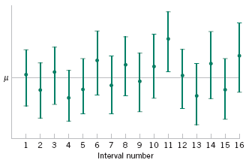
8-2 Confidence Interval on the Mean of a Normal Distribution, Variance Known
Figure 8-1 Repeated construction of a confidence interval for μ.

Slide 19
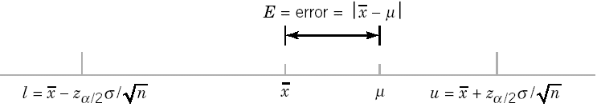



8-2 Confidence Interval on the Mean of a Normal Distribution, Variance Known
Confidence Level and Precision of Error
The length of a confidence interval is a measure of the precision of estimation.
Figure 8-2 Error in estimating μ with .

Slide 20






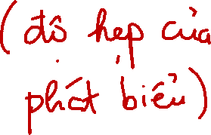


Slide 21
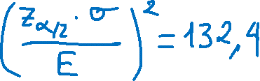



8-2 Confidence Interval on the Mean of a Normal Distribution, Variance Known
8-2.2 Choice of Sample Size
Definition

Slide 22
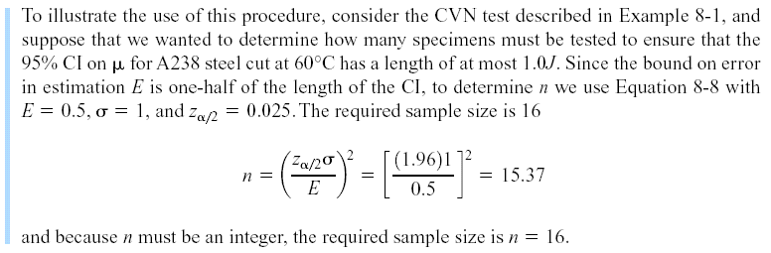
8-2 Confidence Interval on the Mean of a Normal Distribution, Variance Known
Example 8-2

Slide 23











Slide 24
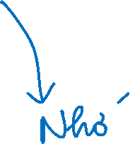

8-2 Confidence Interval on the Mean of a Normal Distribution, Variance Known
8-2.3 One-Sided Confidence Bounds
Definition

Slide 25











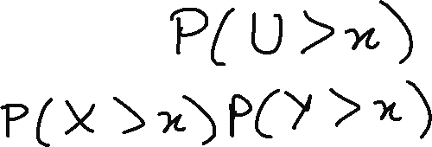





Slide 26

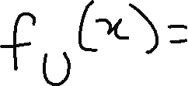







Slide 27

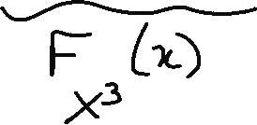







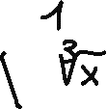








Slide 28


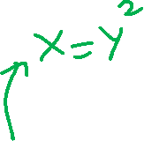

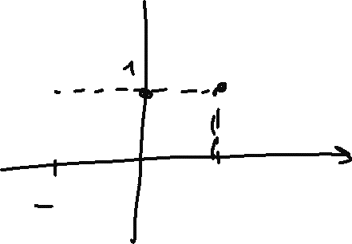




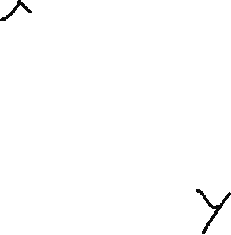








Slide 29

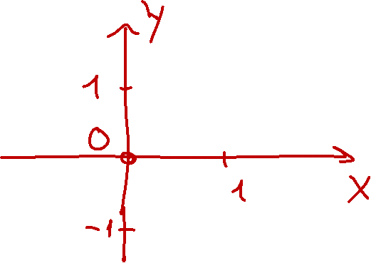







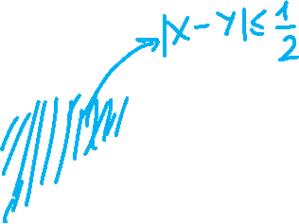










Slide 30



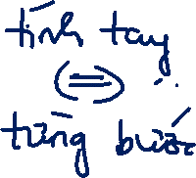






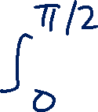



Slide 31

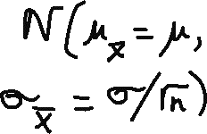







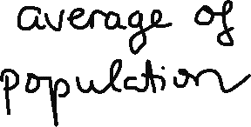

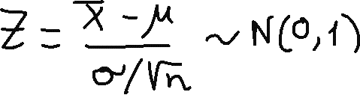

Slide 32


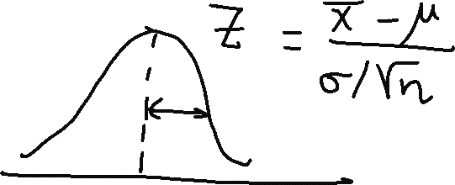




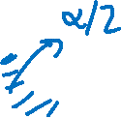

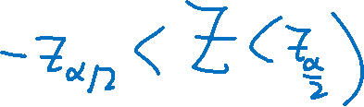

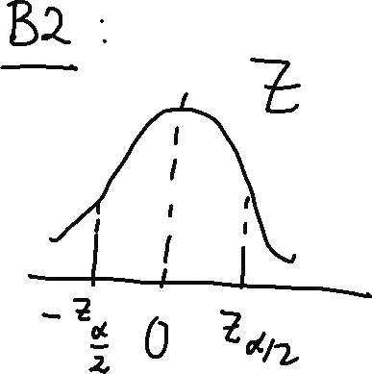


Slide 33





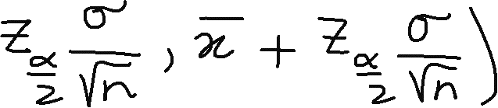







Slide 34


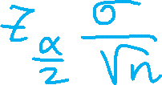







Slide 35





















Slide 36


8-2 Confidence Interval on the Mean of a Normal Distribution, Variance Known
8-2.4 General Method to Derive a Confidence Interval

Slide 37


8-2 Confidence Interval on the Mean of a Normal Distribution, Variance Known
8-2.4 General Method to Derive a Confidence Interval

Slide 38


8-2 Confidence Interval on the Mean of a Normal Distribution, Variance Known
8-2.4 General Method to Derive a Confidence Interval

Slide 39










8-2 Confidence Interval on the Mean of a Normal Distribution, Variance Known
8-2.5 A Large-Sample Confidence Interval for μ
Definition

Slide 40

8-2 Confidence Interval on the Mean of a Normal Distribution, Variance Known
Example 8-4

Slide 41









8-2 Confidence Interval on the Mean of a Normal Distribution, Variance Known
Example 8-4 (continued)

Slide 42



8-2 Confidence Interval on the Mean of a Normal Distribution, Variance Known
Example 8-4 (continued)
Figure 8-3 Mercury concentration in largemouth bass (a) Histogram. (b) Normal probability plot

Slide 43

8-2 Confidence Interval on the Mean of a Normal Distribution, Variance Known
Example 8-4 (continued)

Slide 44

8-2 Confidence Interval on the Mean of a Normal Distribution, Variance Known
A General Large Sample Confidence Interval

Slide 45









8-3 Confidence Interval on the Mean of a Normal Distribution, Variance Unknown
8-3.1 The t distribution

Slide 46




8-3 Confidence Interval on the Mean of a Normal Distribution, Variance Unknown
8-3.1 The t distribution
Figure 8-4 Probability density functions of several t distributions.

Slide 47

8-3 Confidence Interval on the Mean of a Normal Distribution, Variance Unknown
8-3.1 The t distribution
Figure 8-5 Percentage points of the t distribution.

Slide 48


8-3 Confidence Interval on the Mean of a Normal Distribution, Variance Unknown
8-3.2 The t Confidence Interval on μ
One-sided confidence bounds on the mean are found by replacing t_{α/2,n-1} in Equation 8-18 with t _{α,n-1}.

Slide 49
8-3 Confidence Interval on the Mean of a Normal Distribution, Variance Unknown
Example 8-5

Slide 50
8-3 Confidence Interval on the Mean of a Normal Distribution, Variance Unknown
Figure 8-6 Box and Whisker plot for the load at failure data in Example 8-5.

Slide 51
8-3 Confidence Interval on the Mean of a Normal Distribution, Variance Unknown
Figure 8-7 Normal probability plot of the load at failure data in Example 8-5.

Slide 52








8-4 Confidence Interval on the Variance and Standard Deviation of a Normal Distribution
Definition

Slide 53
8-4 Confidence Interval on the Variance and Standard Deviation of a Normal Distribution
Figure 8-8 Probability density functions of several χ² distributions.

Slide 54









Slide 55



Slide 56


8-4 Confidence Interval on the Variance and Standard Deviation of a Normal Distribution
Definition

Slide 57
8-4 Confidence Interval on the Variance and Standard Deviation of a Normal Distribution
One-Sided Confidence Bounds

Slide 58
8-4 Confidence Interval on the Variance and Standard Deviation of a Normal Distribution
Example 8-6

Slide 59


8-5 A Large-Sample Confidence Interval For a Population Proportion
Normal Approximation for Binomial Proportion
The quantity is called the standard error of the point estimator .

Slide 60


















Slide 61

8-5 A Large-Sample Confidence Interval For a Population Proportion

Slide 62

8-5 A Large-Sample Confidence Interval For a Population Proportion
Example 8-7

Slide 63

8-5 A Large-Sample Confidence Interval For a Population Proportion
Choice of Sample Size
The sample size for a specified value E is given by
An upper bound on n is given by

Slide 64
8-5 A Large-Sample Confidence Interval For a Population Proportion
Example 8-8

Slide 65

8-5 A Large-Sample Confidence Interval For a Population Proportion
One-Sided Confidence Bounds

Slide 66














Slide 67







Slide 68


























Slide 69











Slide 70











Slide 71











Slide 72
8-6 Guidelines for Constructing Confidence Intervals

